Slide 1


Slide 2

Data Analytics

Slide 3

Life Cycle
Data Collection
Perparing Insights
Data Perparation
Data Visualization
Data Analysis

Slide 4
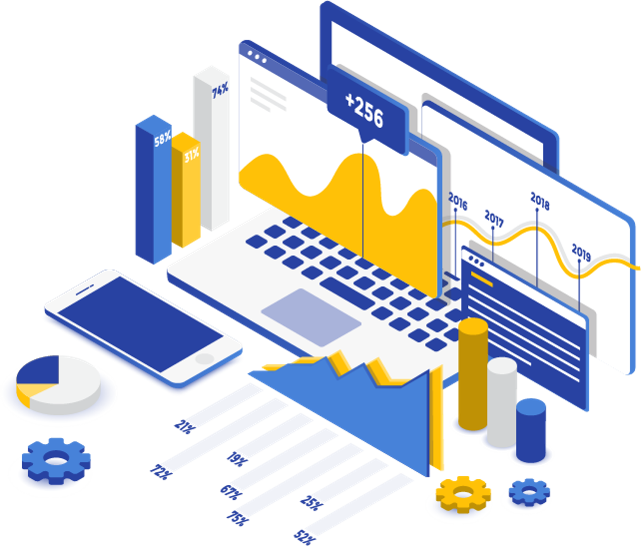
Data Visualization

Slide 5


Analytics Scientist
Vs

Slide 6





Tools

Slide 7







Slide 8

Thank You..!!

